Slide 1

CS 513 B KDD final PROJECT Forecasting Cancellation Flags: A Data-driven Approach to Hotel Reservation Cancellation Prediction Group 1
TEAM MEMBERS:
1. Naveen Mathews Renji
2. Aatish Kayyath
3. Madhura Shinde
4. Abhishek Kocharekar

Slide 2

cONTENTS
PROBLEM STATEMENT
DATASET
DATA DESCRIPTION
DATA PRE-PROCESSING
EXPLORATORY DATA ANALYSIS
PROPOSED METHODOLOGY
CLASSIFICATION MODELS

Slide 3
Problem statement
The high rate of cancellations and no-shows in online hotel reservations has become a challenge for hotels as it impacts their revenue and occupancy rates. While customers benefit from the flexibility of free or low-cost cancellations, hotels have to deal with the revenue-diminishing effect of empty rooms. Hence, there is a need to explore strategies that can help hotels reduce cancellations and no-shows while maintaining customer satisfaction and loyalty. Therefore, the problem at hand is to predict the cancellation flag of a hotel booking based on a set of features, in order to assist hotels in managing their resources and revenue more efficiently.

Slide 4
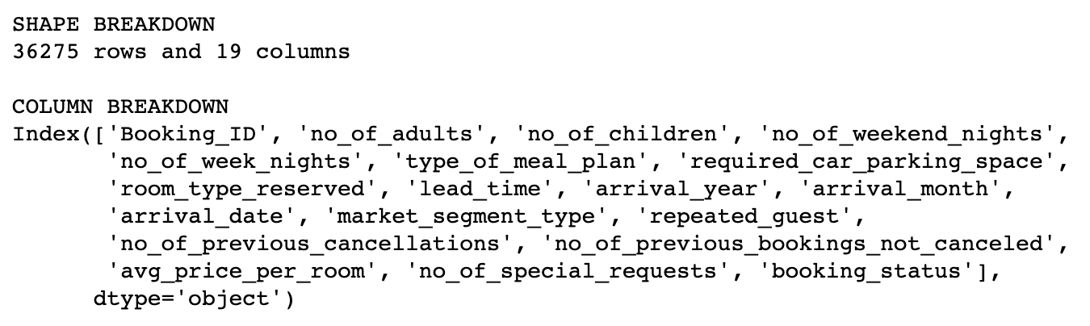
DataSET

Slide 5
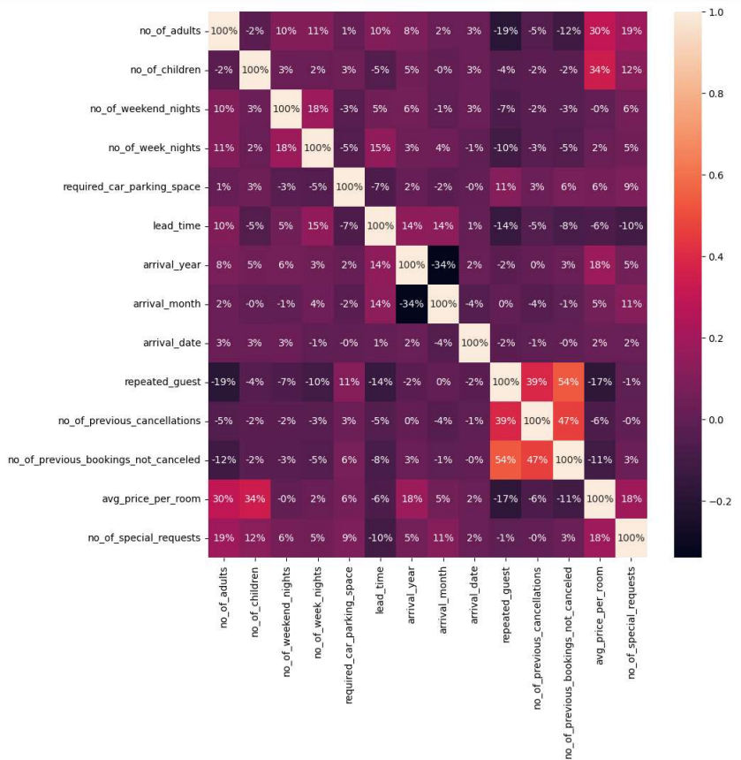
Pearson correlation heatmap

Slide 6
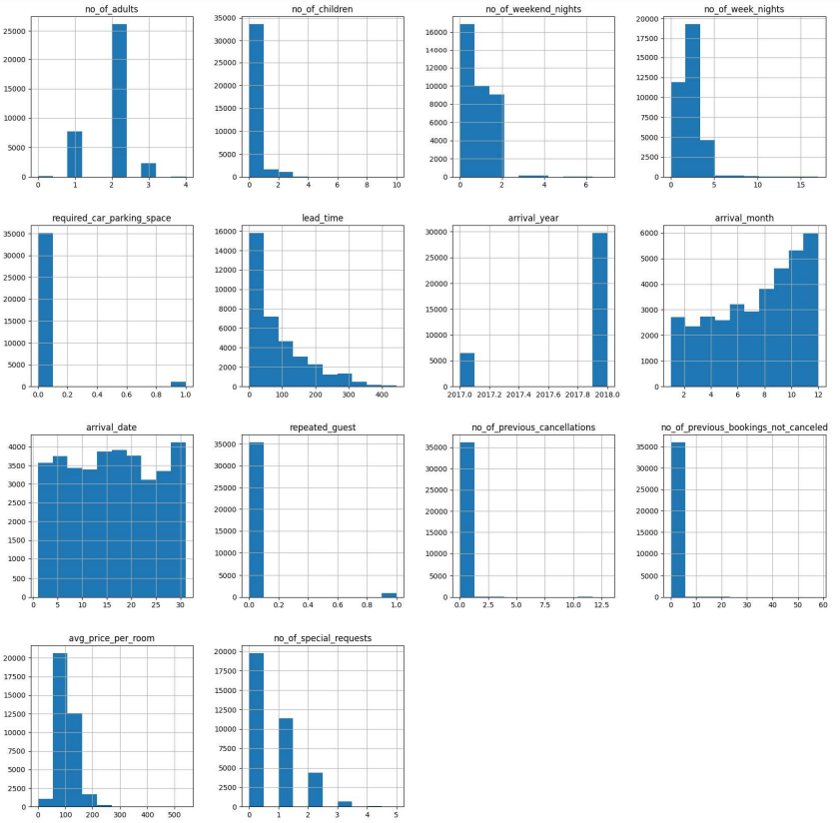
Eda – Frequency distribution

Slide 7
Pre-Processing the Dataset
Converted the categorical variable "booking_status" into a binary numerical variable with values {"Not_Canceled": 0, "Canceled": 1}.
Applied one-hot encoding to the non-numerical columns "type_of_meal_plan", "room_type_reserved", "market_segment_type", "season_group", and "price_per_room_group".
There were no missing values in the dataset.
Applied Z-score outlier removal to the dataset, which reduced the number of rows from 36275 to 24752.
Performed Synthetic Minority Over-sampling Technique (SMOTE) analysis to balance the classes in the dataset. This increased the F-1 score by over 3% - 4% average.
Upon examining the correlation map, a strong positive correlation was observed between the variables "repeated_guests" and "number_of_previous_cancellations" as well as "number_of_previous_bookings_not_cancelled". Since these variables are highly correlated, we will remove two of them as they are redundant.

Slide 8
Proposed methodology
INSTALLING REQUIRED LIBRARIES
MAKE THE NECESSARY IMPORTS
LOADING DATA
SUMMARISING DATA SET
DATA CLEANING
SPLITTING THE DATA FOR TRAINING AND TESTING
IMPLEMENTING CLASSIFICATION MODELS
CALCULATING ACCURACY AND PLOTTING CORRECT VS INCORRECT PREDICTIONS

Slide 9
DIFFERENT CLASSIFICATION MODELS
K-NEAREST NEIGHBOUR
GRADIENT BOOSTING
ADABOOST
LOGISTIC REGRESSION
DECISION TREE
LightGBM
CatBoost
XGBoost
SVM
ANN

Slide 10
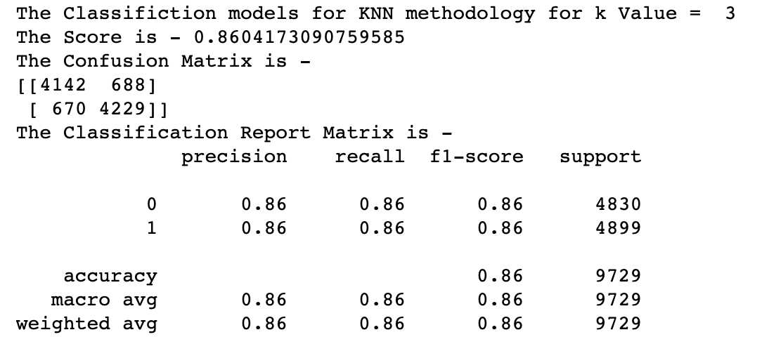
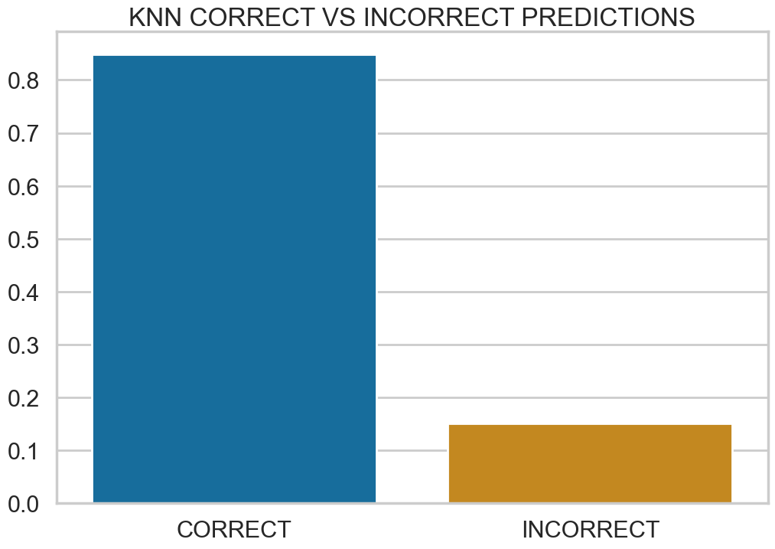
K-Nearest neighbour

Slide 11
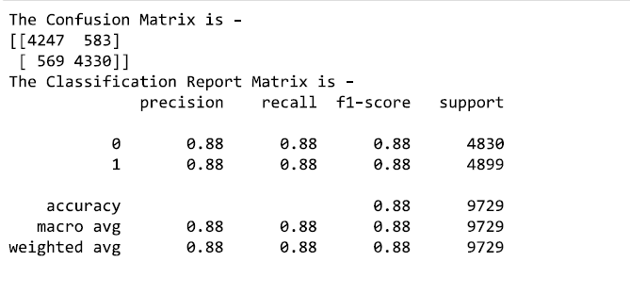
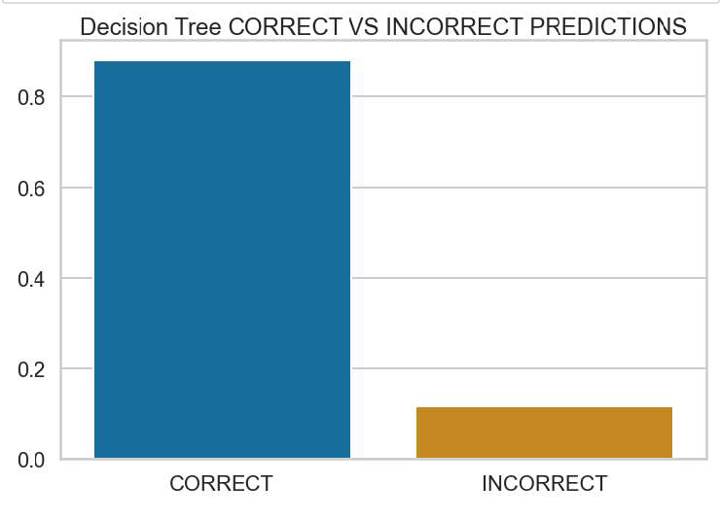
Decision tree

Slide 12
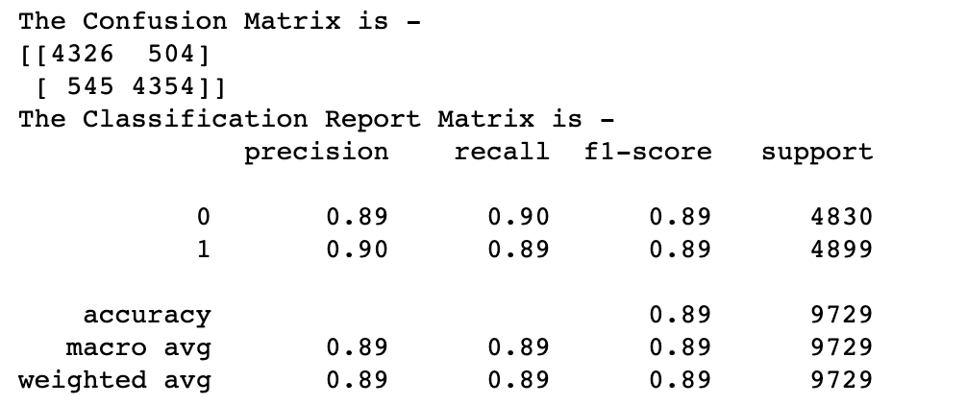
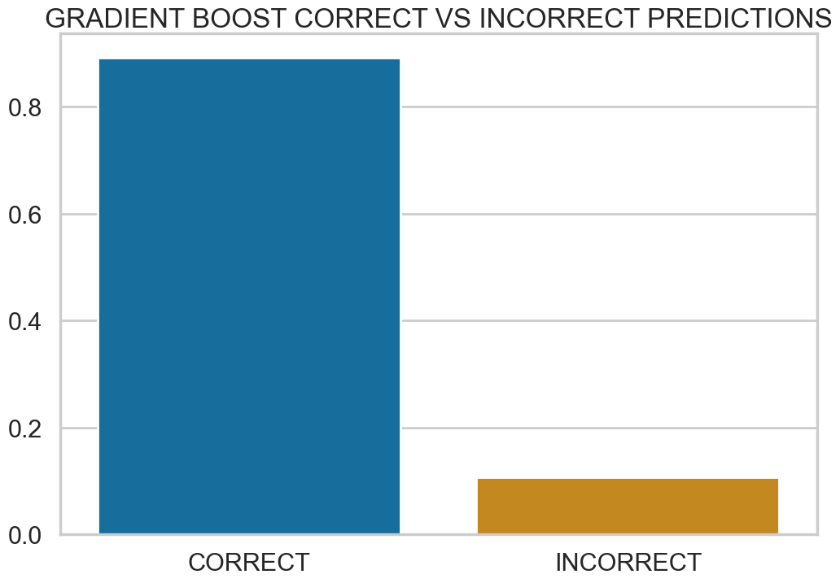
Gradient boosting

Slide 13
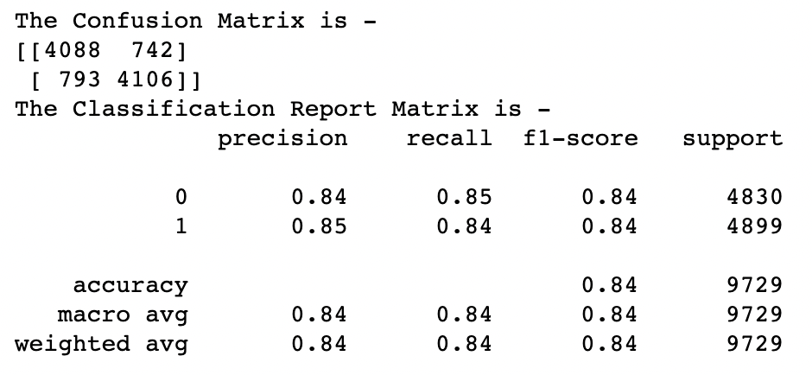
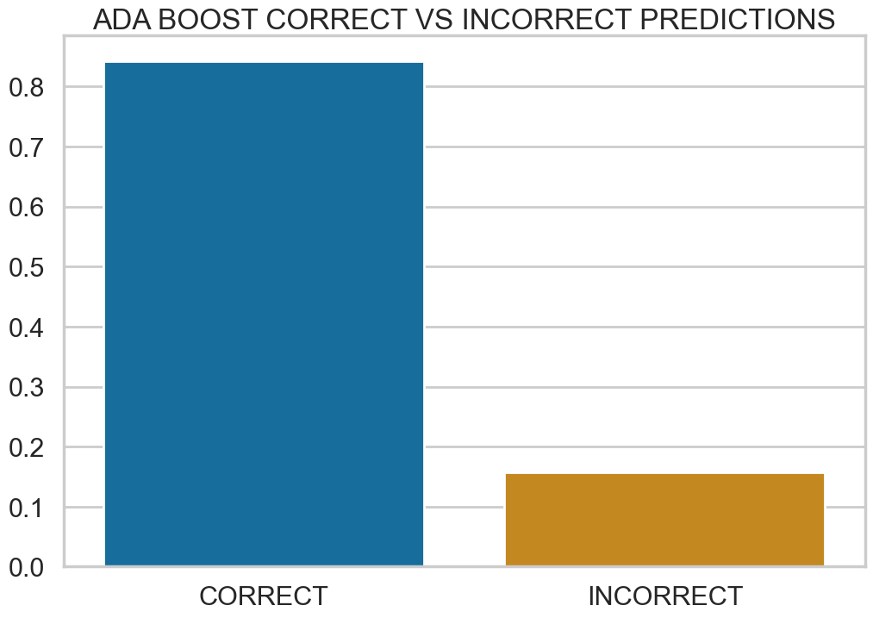
adaboost

Slide 14
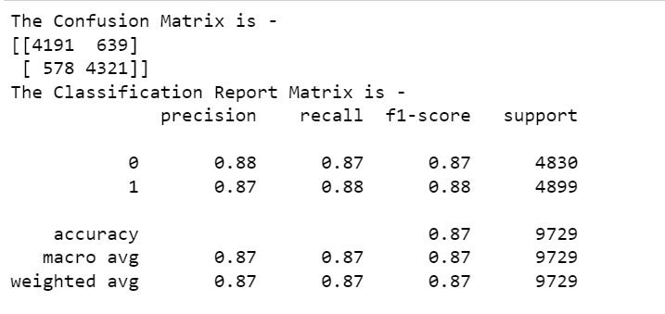
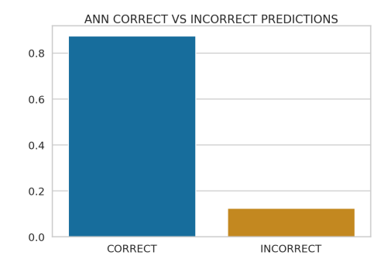
ann

Slide 15
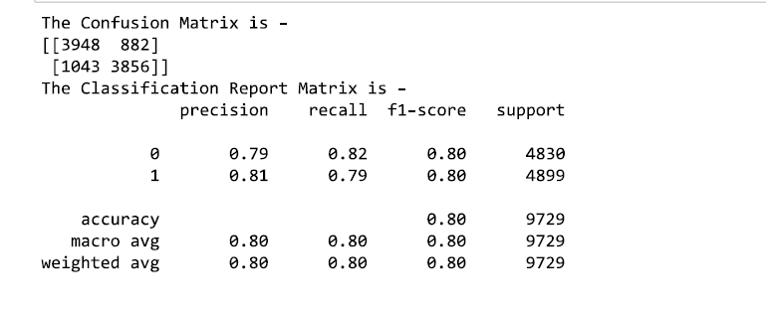
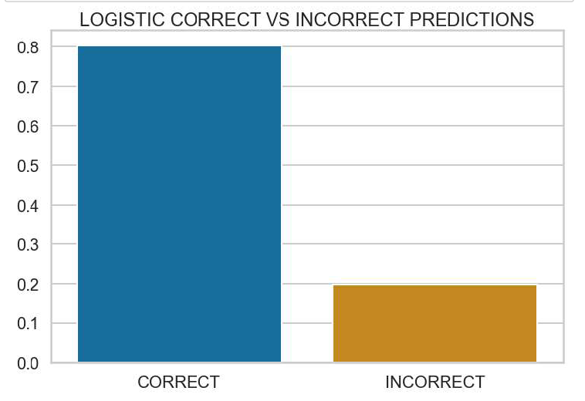
Logistic regression

Slide 16
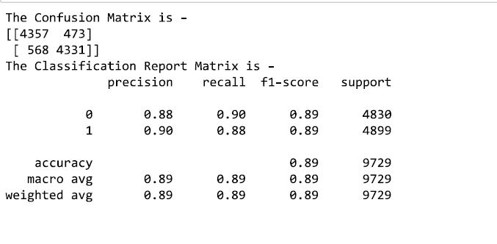
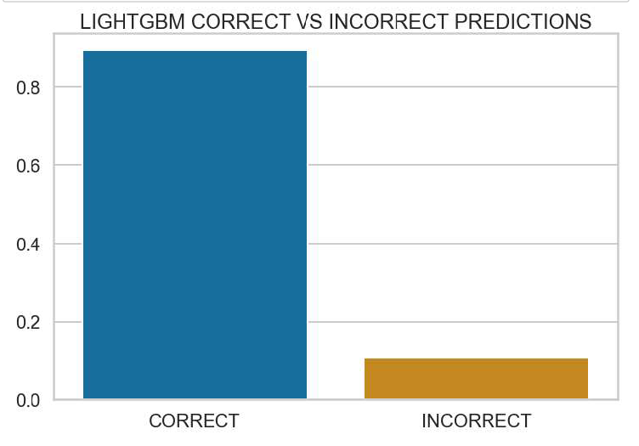
lightgbm

Slide 17
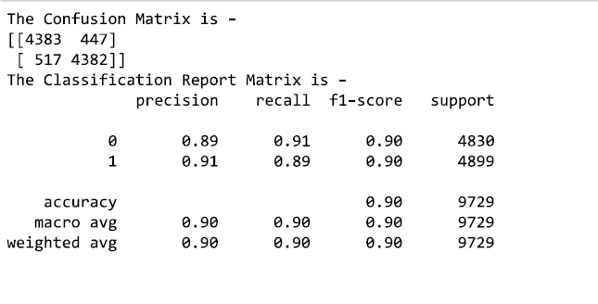
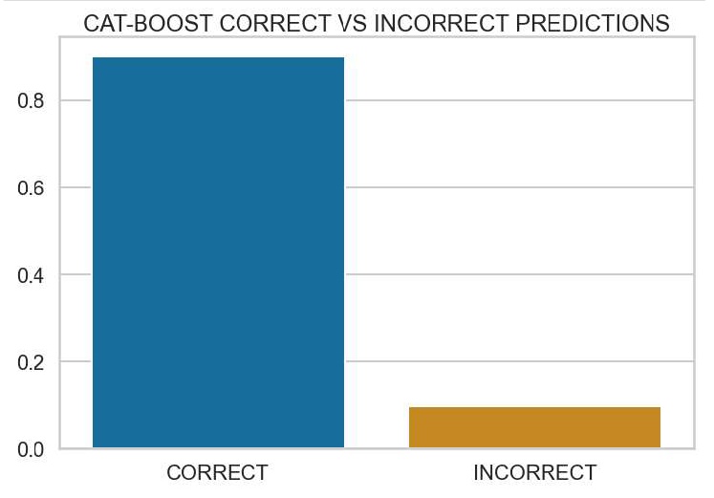
catboost

Slide 18
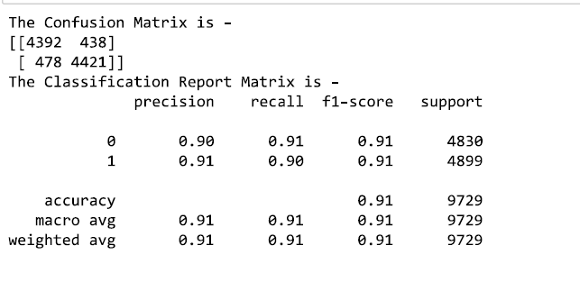

xgBoost

Slide 19

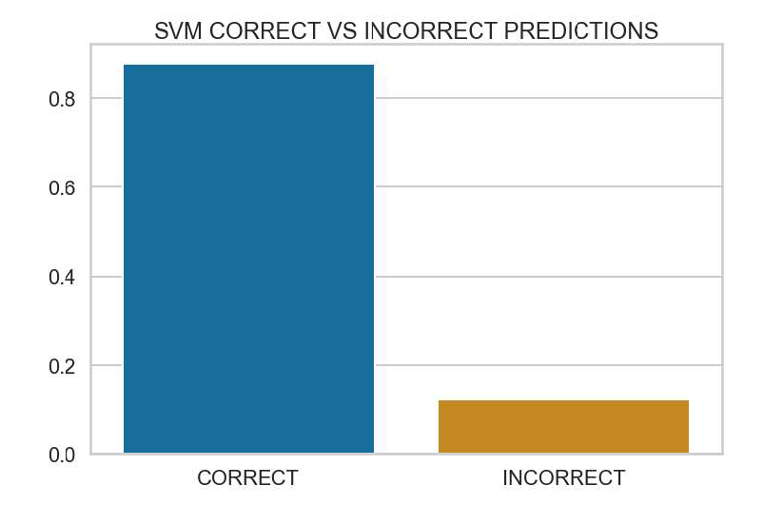
svm

Slide 20
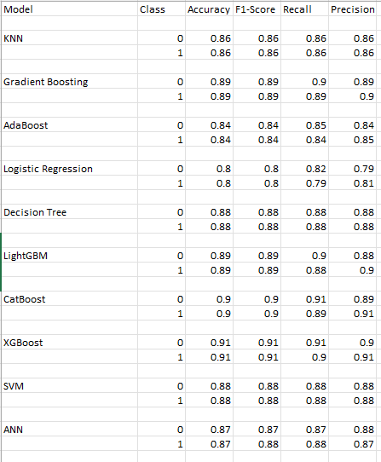
SUMMARY OF ALL MODELS

